Slide 1
EVALUATING MODEL PERFORMANCE
&
HYPERPARAMETER TUNING
DPHI Data Science Bootcamp
Dikscha Sapra

Slide 2
Why evaluate Performance?
To understand how good is our model
To compare it with other models
To generalise how good our model will perform on new data

Slide 3
How to evaluate your Model?
Why do we need different methods for both of them?
CLASSIFICATION
REGRESSION
DISCRETE VARIABLES
CONTINUOUS VARIABLES

Slide 4


CLASSIFICATION ACCURACY
Most basic metrics to evaluate our model
Intuition: All correctly predicted values
All predicted values
X 100
Actual Labels:
Task at hand - Separate Yellow and pink balls
Predicted Labels:
Colors predicted by our model
Correctly predicted = 4. Total = 6
Accuracy = 66.7%

Slide 5
Why Accuracy is not a good metrics?
Baseline Model
Base Model with which we are comparing our performance
Several ways to consider a Baseline Model
We are considering a model which classifies all labels as that of majority class
Actual Labels:
Task at hand - Separate Red and Yellow balls
Predicted Labels:
Majority class is Yellow (4/6), so all are predicted yellow
Accuracy = 4/6 *100 = 66.7
Our model is not better than the baseline model (Which is technically just a nonsense model!)

Slide 6
So what to do?
Confusion Matrix:
For the sake of generalisation, let us call yellow as positive labels, and pink as negative labels.
Actual Labels:
Predicted Labels:
Break down the data into four categories
Actual =Positive, Predicted = Positive
(True Positive)
Actual =Positive, Predicted = Negative
(False Negative)
Actual =Negative, Predicted = Negative
(True Negative)
Actual = Negative, Predicted = Positive
(False Positive)
FN
TP
FP
TP
TP
TN
Actual
Positive Negative
(TP) 3 | (FP) 1
(FN) 1 | (TN) 1
Predicted
Negative Positive

Slide 7
Confusion Matrix:
For the sake of generalisation, let us call yellow as positive labels, and pink as negative labels.
Actual Labels:
Predicted Labels:
AIM
Maximise TP, TN
Minimise FP, FN
Actual
Positive Negative
TP | FP
FN | TN
Predicted
Negative Positive

Slide 8

Other Metrics to Evaluate our Models
Sensitivity
Also called as Recall
True Positive Rate
Correctly guessed as positives compared to total number of positives
Sensitivity = TP
TP+FN
Actual
Positive Negative
TP | FP
FN | TN
Predicted
Negative Positive

Slide 9
Other Metrics to Evaluate our Models
Specificity
Also called as True Negative Rate
Correctly guessed as negatives compared to total number of negatives
Specificity = TN
TN+FP
Actual
Positive Negative
TP | FP
FN | TN
Predicted
Negative Positive

Slide 10
Other Metrics to Evaluate our Models
Precision
Also called as Positive Predictive Value
Correctly guessed as positives compared to total guessed as positives
Precision = TP
TP+FP
Actual
Positive Negative
TP | FP
FN | TN
Predicted
Negative Positive

Slide 11
Other Metrics to Evaluate our Models
F1-Score
Harmonic Mean of Precision and Recall
Penalises False negatives and false positives.
Mostly used for uneven class distribution
Precision = 2*Precision*Recall
Precision+Recall
Actual
Positive Negative
TP | FP
FN | TN
Predicted
Negative Positive

Slide 12
Other Metrics to Evaluate our Models
Matthews Correlation Coefficient
Cross Product of different terms
Penalises False negatives and false positives.
Actual
Positive Negative
TP | FP
FN | TN
Predicted
Negative Positive
Mostly used for uneven class distribution
MCC = TP * TN - FP * FN
(TP + FP) * (FN + TN) * (FP + TN) * (TP + FN)
Notes:
Good Resources: https://lettier.github.io/posts/2016-08-05-matthews-correlation-coefficient.html

Slide 13
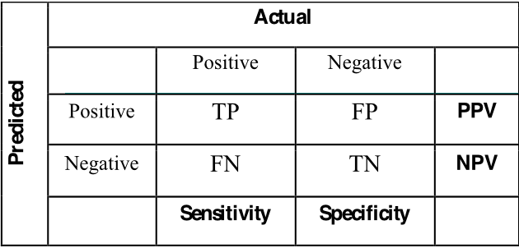
Confusion Matrix Summary
(Precision)
Notes:
Good Resources: https://lettier.github.io/posts/2016-08-05-matthews-correlation-coefficient.html

Slide 14
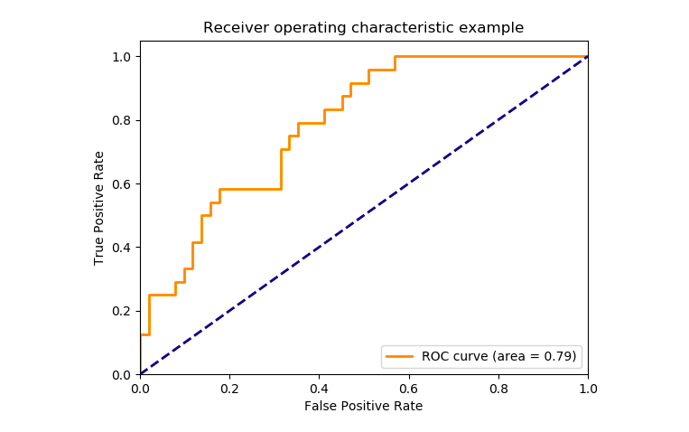
ROC-AUC
Receiver Operating Characteristics - Area under the Curve
(CLICK HERE TO EXPERIMENT)
Threshold based evaluation metrics
Also called Precision Recall Curve
Tells the optimal threshold to select, depending on the true and the false positive rate
Notes:
Watch for better explanation: https://www.youtube.com/watch?v=4jRBRDbJemM

Slide 15
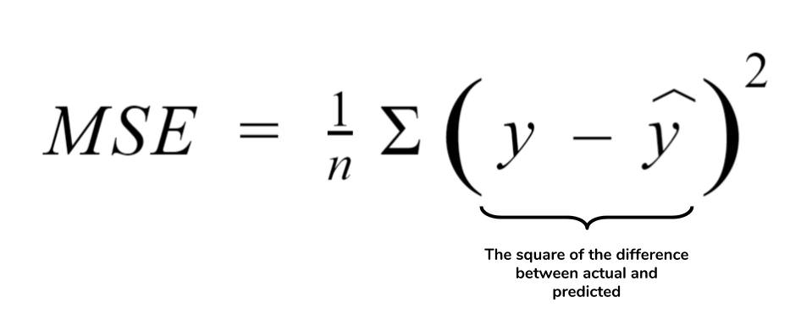
REGRESSION METRICS
MEAN SQUARED ERROR
It is simply the average of the squared difference between the target value and the value predicted by the regression model.
As it squares the differences, it penalizes even a small error which leads to over-estimation of how bad the model is.
MSE or Mean Squared Error is one of the most preferred metrics for regression tasks.

Slide 16
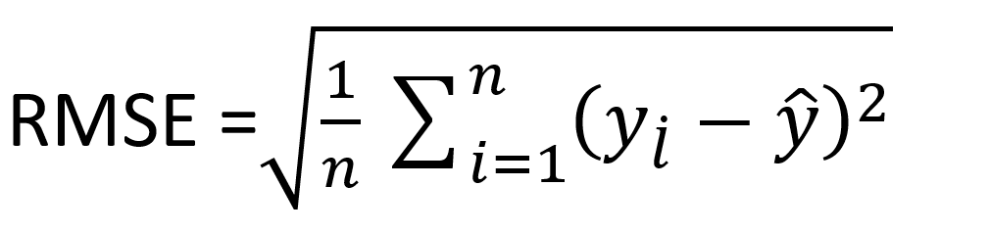
REGRESSION METRICS
ROOT MEAN SQUARED ERROR
RMSE is the square root of the averaged squared difference between the target value and the value predicted by the model.
It is preferred more in some cases because the errors are first squared before averaging which poses a high penalty on large errors.
This implies that RMSE is useful when large errors are undesired.

Slide 17
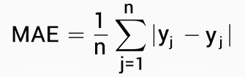
REGRESSION METRICS
MEAN ABSOLUTE ERROR
The MAE is more robust to outliers and does not penalize the errors as extremely as mse
MAE is the absolute difference between the target value and the value predicted by the model.

Slide 18
What Metrics to use When?
Depends on the Dataset
Classification
Fraud Detection: Every Non-Fraud transaction that gets classified as Fraud does not bear that heavy a cost, at the maximum - the person will get one extra phone call to check whether the transaction is fraudulent or not. BUT! Every fraud transaction that goes undetected and unchecked - will incur a huge cost!
THEREFORE False positives are not as important as False Negatives
SPECIFICITY >> SENSITIVITY

Slide 19
What Metrics to use When?
Depends on the Dataset
Classification
Disease Detection: If a healthy person is falsely detected, it is problematic since they may undergo unnecessary surgery/treatment. If a diseased person is falsely detected as healthy, the disease may progress further to an advanced stage.
THEREFORE False positives and False Negatives both important
SPECIFICITY and SENSITIVITY are both important

Slide 20
What Metrics to use When?
Depends on the Dataset
Classification
Recommendation Systems: Suppose we recommend certain items to a user, this is what the metrics terms mean wr.t. Recommendation systems:
SENSITIVITY: Ratio of total useful items recommended to total items that are liked by the user
PRECISION: ratio of total useful items recommended to the total number of items recommended.
SPECIFICITY: Total Non useful items guessed by the recommendation system, to the total items not liked by the user
Sensitivity and Precision are important, but not Specificity!

Slide 21
What Metrics to use When?
Depends on the Dataset
Regression
MSE: When we want to penalize even small errors
MSE: When we want to penalize outliers
MAE: When we do not want of penalise outliers that much
RMSE: Useful when large errors are undesired.

Slide 22

Good Rule of Thumb
If unsure, or in general - Report all of these metrics!
Most of these are provided in sklearn.

Slide 23
CROSS VALIDATION
We know how our model performs on seen data, but how do we be sure on how it performs on new data?
What if less data is available - which makes it difficult to separate data for training and testing
What if our training and testing was sampled in such a way that there is a certain bias which causes the testing dataset to perform better than it would on new and unknown data?
Answer: Cross Validate your data

Slide 24
WIDELY USED CROSS VALIDATION METHODS
There are many different types of cross validation that exist, however we will be discussing the two most common types.
k-Fold Cross Validation
Leave One Out CV (LOOCV)
Divide Data into K Folds
Let’s take k=3 for example
All but one sample is chosen as training set
Testing
Testing
Testing
Testing
Testing
Testing
k=1
k=2
k=3

Slide 25
WIDELY USED CROSS VALIDATION METHODS
k-Fold Cross Validation
Leave One Out CV (LOOCV)
Used on larger datasets
Used on smaller datasets
Computationally Expensive
Best results
LOOCV is a special case of k-Fold CV
When k=size(data)-1, only one row is the testing set, others are training which is nothing but LOOCV!

Slide 26

HYPERPARAMETER TUNING
For any classifier/regressor that we use, there are a lot of parameters and hyperparameters.
For example - Neural Networks
How to find the best values for each of these parameters?
Testing out all of these will take a huge amount of time!
NUMBER OF LAYERS
ALPHA
NUMBER OF ITERATIONS
BETA
ACTIVATION FUNCTION
BATCH SIZE
Solution: GridSearchCV in sklearn
NUMBER OF NODES
LEARNING RATE

Slide 27
GRID SEARCH CV
Input all different values you want to check the performance on.
Input the metrics you want to optimize the results on (Accuracy, Sensitivity, Specificity, AUC-ROC)
Cross Validate results however many times required
Try it using sklearn!

Slide 28
GRID SEARCH CV
Total iterations to be carried out = 3*2*3*4 = 72 times
NUMBER OF LAYERS
ALPHA
ACTIVATION FUNCTION
NUMBER OF NODES
5
10
50
0.1
0.05
relu
sigmoid
10
250
Performance of each will be ranked on the basis of what scoring metrics is provided
tanh
50
100
PROBLEM?
Computationally too expensive!
A simple dataset with 500 rows can take upto hours to compute the best results (depending on the model).
Even addition of a single new value of one hyperparameter will increase the computation time by a lot (order of total number of hyper parameter values).
Solution - RandomisedSearchCV
Return best model hyperparameters

Slide 29
RANDOMISED SEARCH CV
Input all different values you want to check the performance on.
Input number of iterations you want (searches the grid only that many number of times)
Faster than GridSearch, since it does not search the entire sample space
Finds close to optimal solution
Works good on larger data sets.
One can use Randomised Search to find close to optimal solution, and then tune it further on Grid Search CV.

Slide 30
Downloadable link of slides: https://docs.google.com/presentation/d/12MKC7mk0duQwnK6gl37YITfHB4VHMuWybeUidDOC33Y/edit#slide=id.g8a779c1af3_0_0

